Slide 1
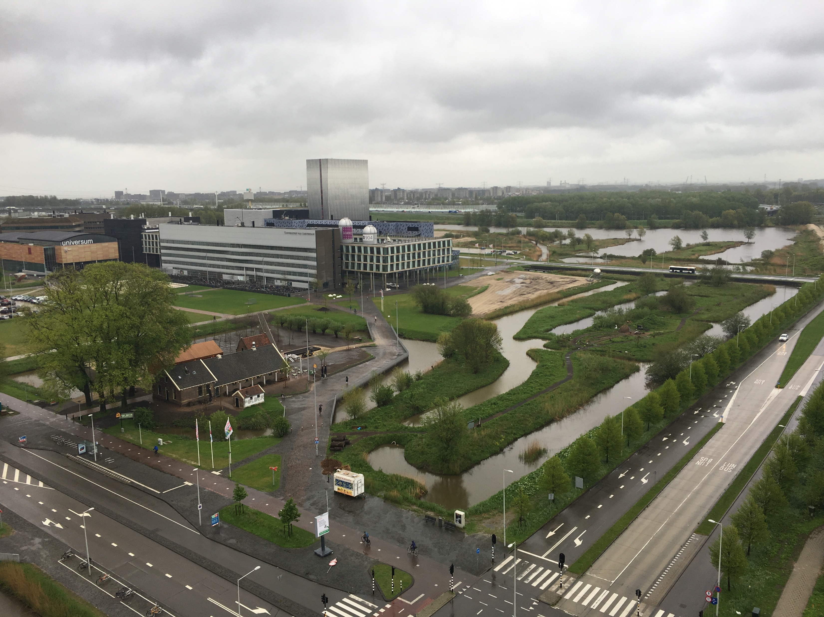


Hundred Young Academic Leaders Program of Nankai University
Georgios A. Siviloglou
8 May, 2018

Slide 2
Basic personal information
Basic information
Place of birth: Athens, Greece
Date of birth: 27.09.1978
Education
1996 – 2003 NTUA, Greece Diploma of Electrical Engineering
2004 – 2010 CREOL, USA PhD in Optics
Research
2010 – 2014 MIT, USA Postdoc and Research Scientist
2014 – 2018 UvA, Holland Postdoc and Marie Curie Fellow

Slide 3

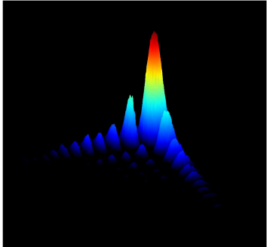
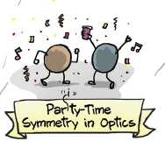
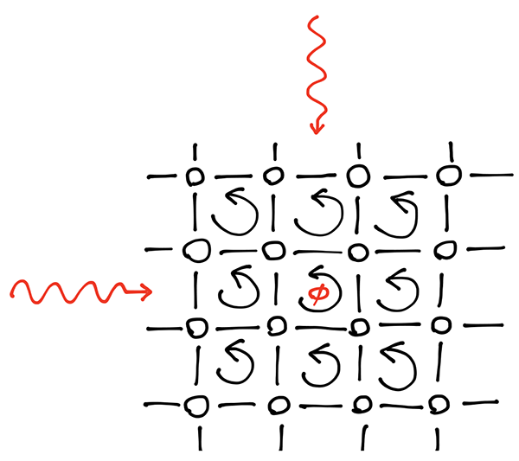
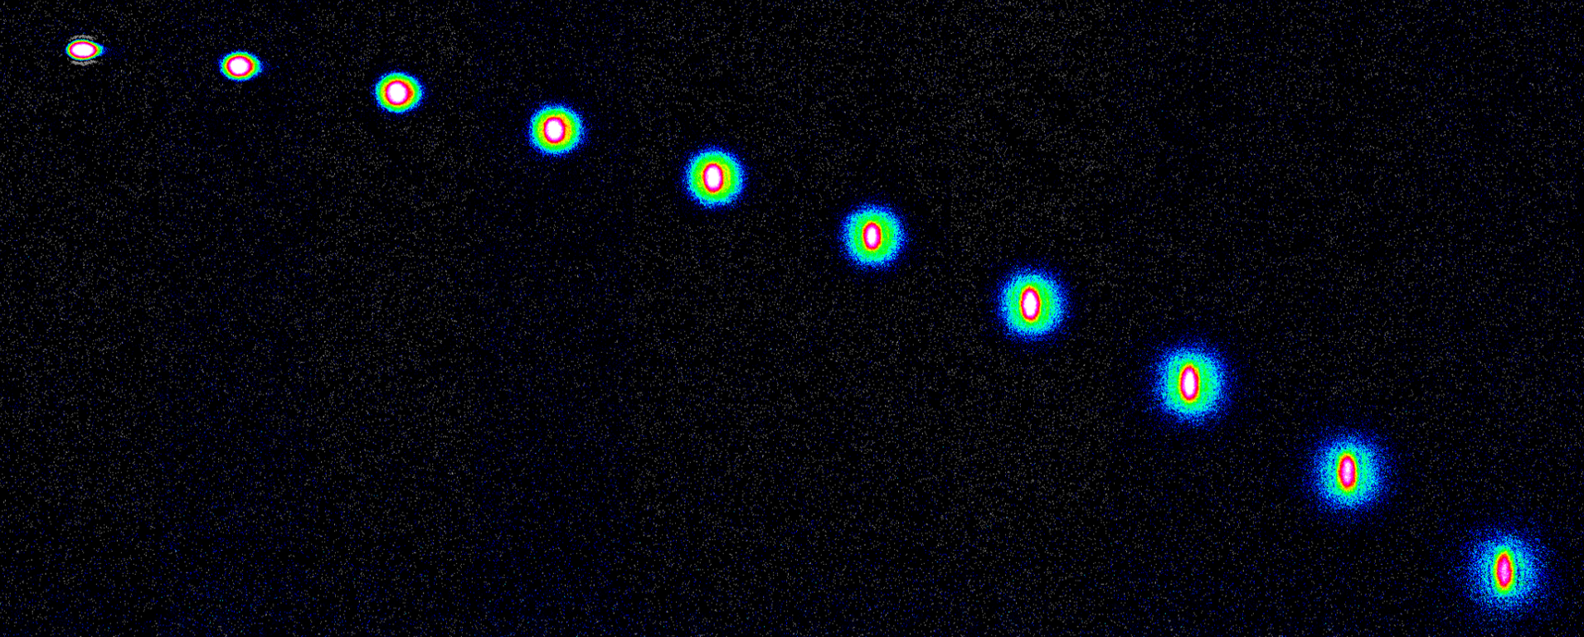
Main research accomplishments
7 papers in the top 1% in the field of Physics (ISI Web of Science)
Self-bending Airy beams (>2000 citations)
𝒫𝒯-symmetry (1005 citations)
Hofstadter Hamiltonian (citations 449)
Quantum gases of strontium

Slide 4

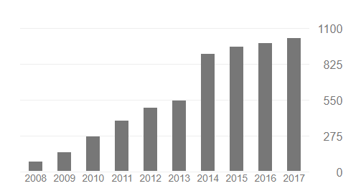

Publication summary
18 + 1 (in preparation) peer-reviewed articles
Among them 6 Phys. Rev. Lett. and 1 Science
4 publications in Optics and Photonics News (published by OSA)
1 invited book chapter
Total citations > 4250
7 papers in the top 1% of physics
224 citations per paper
Citations per year

Slide 5
Publication list
J. Schachenmayer, D. M. Weld, H. Miyake, G. A. Siviloglou, W. Ketterle, and A. J. Daley, " Adiabatic cooling of bosons in lattices to magnetically ordered quantum states" Physical Review A 92, 041602(R) (2015). (ISI citations 5)
H. Miyake, G. A. Siviloglou, C. J. Kennedy, W. C. Burton, and W. Ketterle, "Realizing the Harper Hamiltonian with Laser-Assisted Tunneling in Optical Lattices" Physical Review Letters 111, 185302 (2013). (ISI citations 431)
C. J. Kennedy, G. A. Siviloglou, H. Miyake, W. C. Burton, and W. Ketterle, "Spin-Orbit Coupling and Spin Hall Effect for Neutral Atoms without Spin Flips" Physical Review Letters 111, 225301 (2013). (ISI citations 75)
H. Miyake, G. A. Siviloglou, G. Puentes, D. E. Pritchard, W. Ketterle, and D. M. Weld. "Bragg scattering as a probe of atomic wave functions and quantum phase transitions in optical lattices" Physical Review Letters 107, 175302 (2011). (ISI citations 37)
G. A. Siviloglou, J. Broky, A. Dogariu, and D. N. Christodoulides, "Observation of Accelerating Airy Beams" Physical Review Letters 99, 213901 (2007). (ISI citations 845)
P. Polynkin, M. Kolesik, J. V. Moloney, G. A. Siviloglou, D. N. Christodoulides, "Curved Plasma Channel Generation Using Ultraintense Airy Beams" Science 324, 229-232 (2009). (ISI citations 396)
A. Guo, G. J. Salamo, D. Duchesne, R. Morandotti, M. Volatier-Ravat, V. Aimez, G. A. Siviloglou, and D. N. Christodoulides, "Observation of PT-Symmetry Breaking in Complex Optical Potentials" Physical Review Letters 103, 093902 (2009). (ISI citations 948)
J. Shu, J. Lee, J. W. Fleischer, G. A. Siviloglou, and D. N. Christodoulides, "Diffusion-trapped Airy beams in photorefractive media" Physical Review Letters 104, 253904 (2010). (ISI citations 59)

Slide 6
Publication list
G. A. Siviloglou and D. N. Christodoulides, "Accelerating finite energy Airy beams" Optics Letters 32, 979-981 (2007). (ISI citations 692)
G. A. Siviloglou, J. Broky, A. Dogariu, and D. N. Christodoulides, "Ballistic dynamics of Airy beams" Optics Letters 33, 207-209 (2008). (ISI citations 213)
G. A. Siviloglou, K. G. Makris, R. Iwanow, R. Schiek, D. N. Christodoulides, G. I. Stegeman, Y. Min, and W. Sohler, "Observation of discrete quadratic surface solitons" Optics Express 14, 5508-5516 (2006). (ISI citations 67)
G. A. Siviloglou, S. Suntsov, R. El-Ganainy, R. Iwanow, G. I. Stegeman, D. N. Christodoulides, R. Morandotti, D. Modotto, A. Locatelli, C. De Angelis, F. Pozzi, C. R. Stanley, and M. Sorel,
"Enhanced third-order nonlinear effects in optical AlGaAs nanowires" Optics Express 14, 9377-9384 (2006). (ISI citations 42)
J. Broky, G. A. Siviloglou, A. Dogariu, and D. N. Christodoulides, "Self-healing properties of optical Airy beams" Optics Express 16, 12880-12891 (2008). (ISI citations 378)
S. Suntsov, K. G. Makris, G. A. Siviloglou, R. Iwanow, R. Schiek, D. N. Christodoulides, G. I. Stegeman, R. Morandotti, H. Yang, G. Salamo, M. Volatier, V. Aimez, R. Ares, M. Sorel, Y. Min, W. Sohler, X. S. Wang, A. Bezryadina, Z. G. Chen, "Observation of one- and two-dimensional discrete surface spatial solitons" Journal of Nonlin. Opt. Phys. & Mat. 16, 401-426 (2007). (Invited Paper) (ISI citations 33)
N. K. Efremidis, G. A. Siviloglou, and D. N. Christodoulides, "Exact X-wave solutions of the hyperbolic nonlinear Schrödinger equation with a supporting potential" Physics Letters A 373, 4073 (2009). (ISI citations 5)
T. J. Eichelkraut, G. A. Siviloglou, I. M. Besieris, and D. N. Christodoulides,
“Oblique Airy wave packets in bidispersive optical media”
Optics Letters 35, 3655 (2010). (ISI citations 18)

Slide 7
Publication list
N. Barbieri, M. Weidman, G. Katona, M. Baudelet, Z. Roth, E. Johnson, G. A. Siviloglou, D. N. Christodoulides, and M. Richardson, "Double helical laser beams based on interfering first-order Bessel beams" J. Opt. Soc. Am. A 28, 1462 (2011). (ISI citations 11)
M. S. Mills, G. A. Siviloglou, N. Efremidis, T. Graf, E. M. Wright, J. V. Moloney, D. N. Christodoulides, "Localized Waves with Spherical Harmonic Symmetries" Physical Review A 86.6 (2012). (ISI citations 4)

Slide 8
Other publications
Other publications
P. Polynkin, M. Kolesik, J. Moloney, G. A. Siviloglou, and D. Christodoulides,
“Extreme Nonlinear Optics with Ultra-Intense Self-Bending Airy Beams”
Optics and Photonics News, September 2010 (Invited publication)
P. Polynkin, M. Kolesik, J. Moloney, G. A. Siviloglou, and D. Christodoulides,
“Curved Plasma Channel Generation in Air Using Ultra-Intense Self-Bending Airy Beams”
Optics and Photonics News, Optics in 2009, December 2009
G. A. Siviloglou, J. Broky, A. Dogariu, and D. Christodoulides,
“Airy Beams: A New Class of Optical Waves”
Optics and Photonics News, Optics in 2008, December 2008
F. Pozzi, M. Sorel, G.A. Siviloglou, S. Suntsov, R. El-Ganainy, R. Iwanow, G.I. Stegeman,
D.N. Christodoulides, D. Modotto, A. Locatelli, C. De Angelis and R. Morandotti,
“Enhanced Third-Order Nonlinear Effects in Ultra-Compact AlGaAs Nanowires”
Optics and Photonics News, Optics in 2006, December 2006
Book chapter
Y. Hu, G. A. Siviloglou, P. Zhang, N. K. Efremidis, D. N. Christodoulides, and Z. Chen.
Self-accelerating Airy beams: generation, control, and applications.
In Nonlinear Photonics and Novel Optical Phenomena, pp. 1-46. Springer New York, 2012.

Slide 9
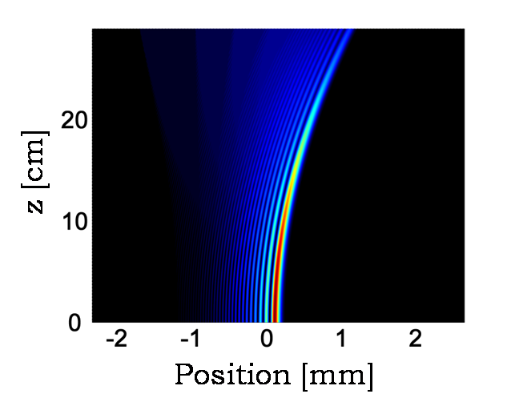
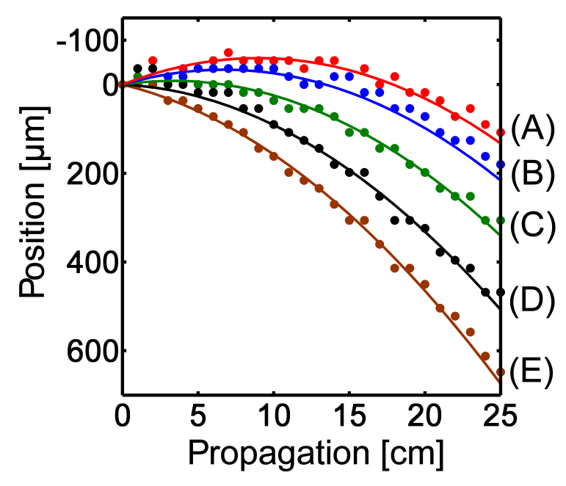
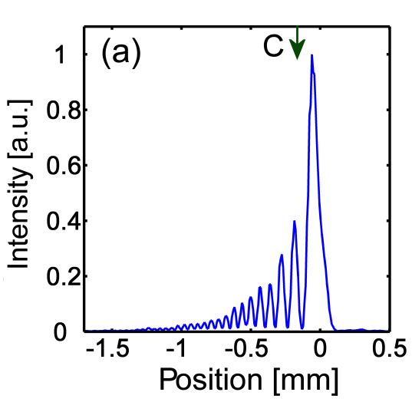
Optical Airy beams
Beam propagation
Position of the beam maximum
Beam profile
G. A. Siviloglou and D. N. Christodoulides, Opt. Lett. 32, 979 (2007). (cited 878)
G. A. Siviloglou, J. Broky, A. Dogariu, and D. N. Christodoulides, Phys. Rev. Lett. 99, 213901 (2007) (cited 718)
G. A. Siviloglou, J. Broky, A. Dogariu, and D. N. Christodoulides, Opt. Lett. 33, 207 (2008) (cited 213)

Slide 10
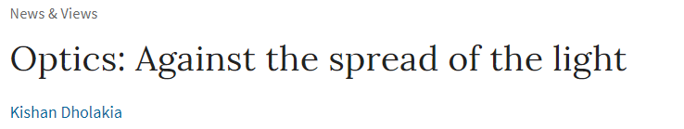


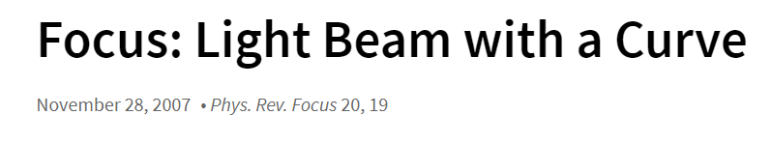
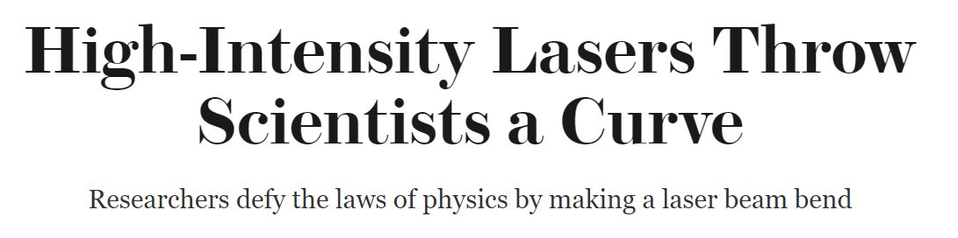


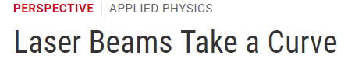
Optical Airy beams
G. A. Siviloglou and D. N. Christodoulides, Opt. Lett. 32, 979 (2007).
G. A. Siviloglou, J. Broky, A. Dogariu, and D. N. Christodoulides, Phys. Rev. Lett. 99, 213901 (2007)
P. Polynkin, M. Kolesik, J. V. Moloney, G. A. Siviloglou, and D. N. Christodoulides, Science 324, 229 (2009) (cited 396)

Slide 11
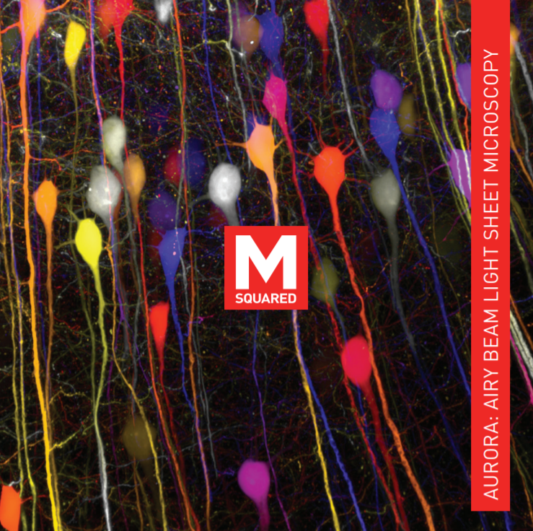
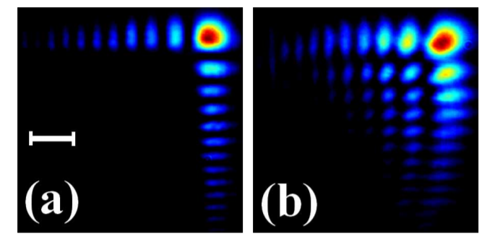
Why non-diffracting, self-bending Airy beams are important?
Commercial Airy microscopy
Self-healing
500x faster than confocal microscopy
Robust even in biological tissue
D. Christodoulides, A. Dogariu, and G. Siviloglou United States Patent US 8,101,929 B1 (2012)
J. Broky, G. A. Siviloglou, A. Dogariu, and D. N. Christodoulides, Opt. Express 16, 12880 (2008) (cited 378)

Slide 12
From optics to ultracold quantum gases

Slide 13
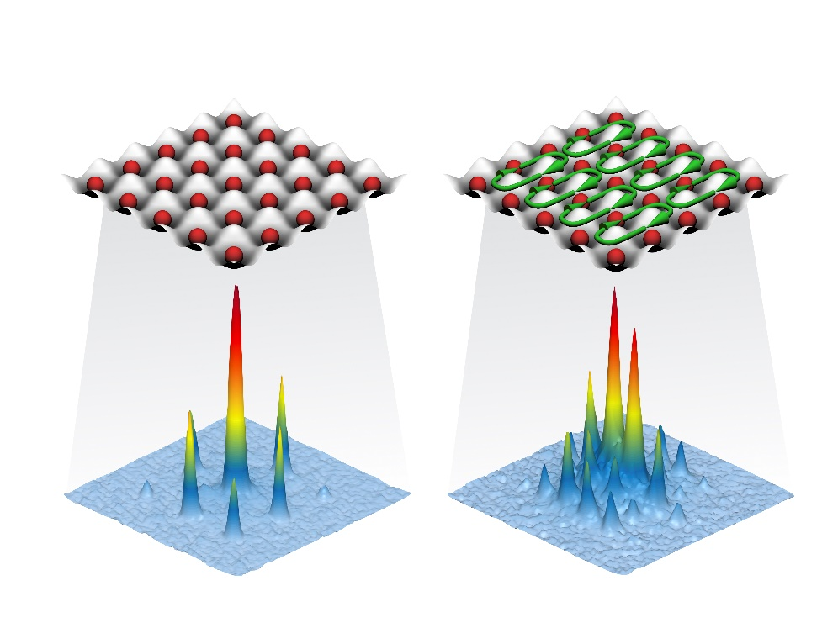
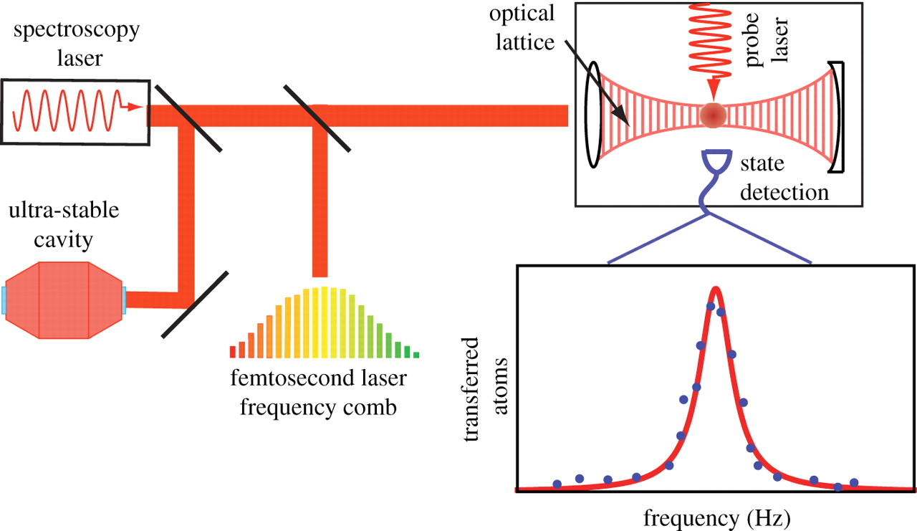
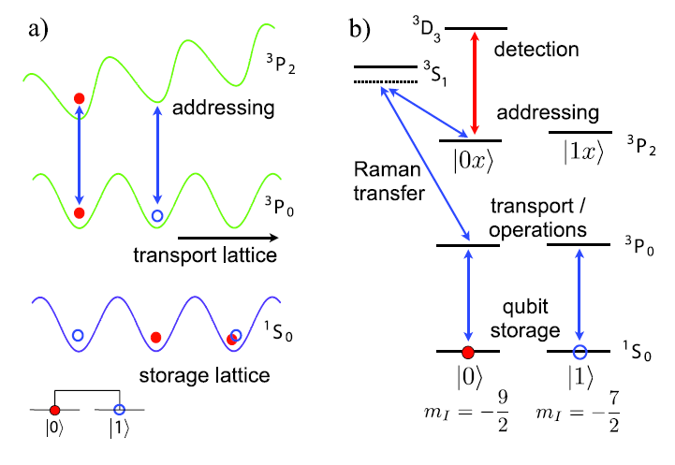
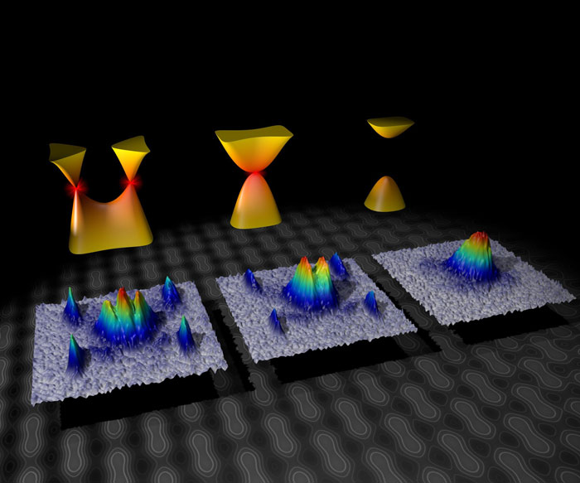
Applications and quantum simulation with ultracold atoms
Strong magnetic fields
Lattice clocks
Quantum
computing
Graphene physics

Slide 14
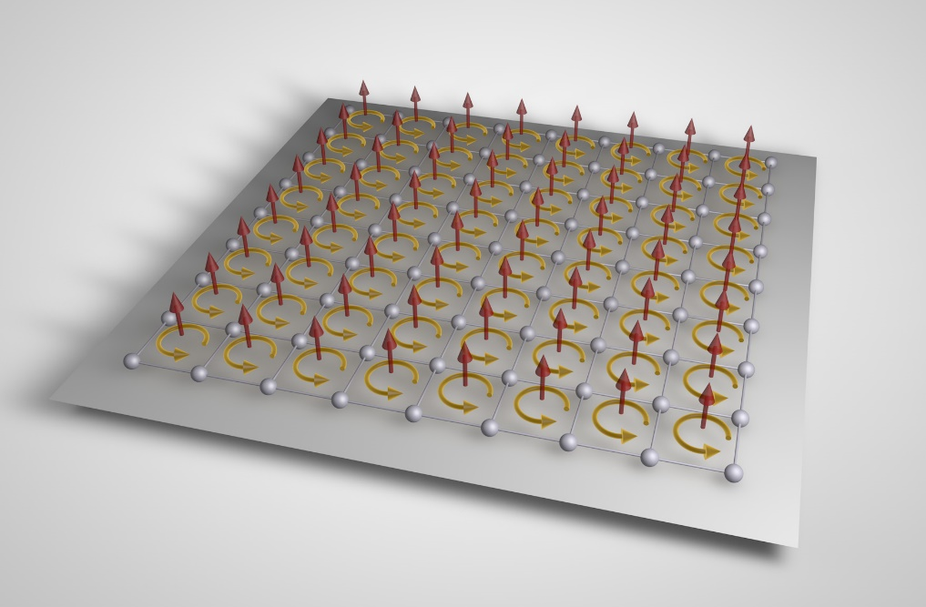

The Hofstadter-Harper Hamiltonian
14
Created for the first time the Hofstadter Hamiltonian in an atomic system
Hofstadter butterfly spectrum
MPQ
Previous experiments had less than one vortex per 1000 atoms
P. G. Harper, Proceedings of the Physical Society. Section A 68, 874 (1955)
D. R. Hofstadter, Phys. Rev. B 14, 2239 (1976)

Slide 15
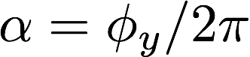
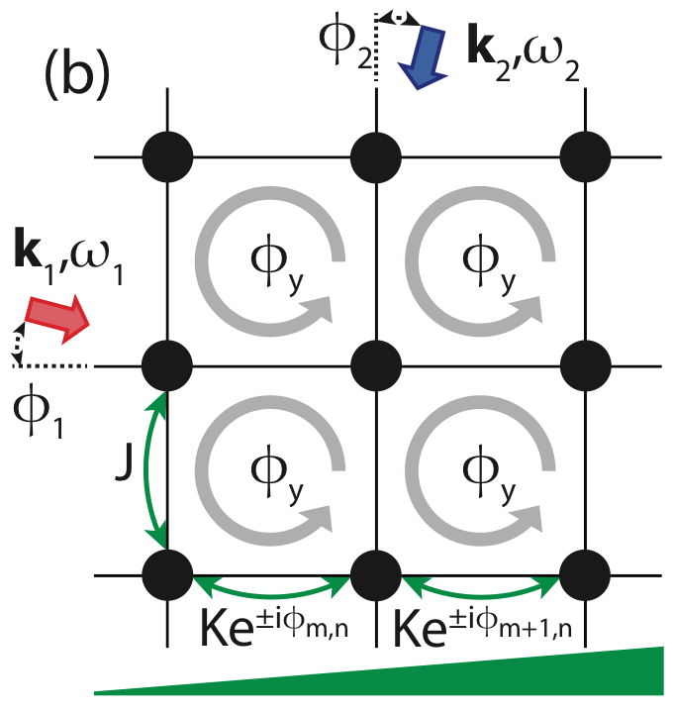
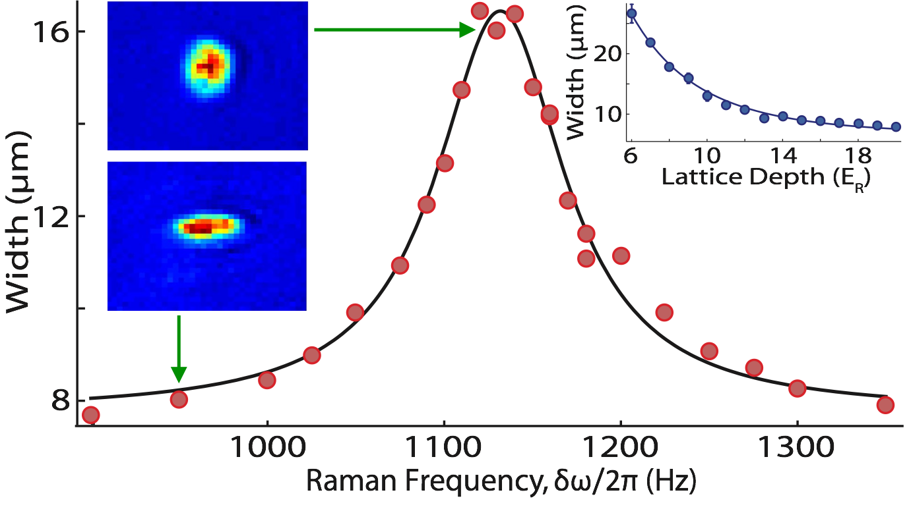
Strong synthetic fields for neutral atoms
15
Larger width corresponds to stronger coupling
Scheme to induce complex tunneling
When ω2-ω1 = Δ resonant tunneling is established
M. Aidelsburger, M. Atala, M. Lohse, J. T. Barreiro, B. Paredes, and I. Bloch, Phys. Rev. Lett. 111, 185301 (2013)
H. Miyake, G. A. Siviloglou, C. J. Kennedy, W. C. Burton, and W. Ketterle, Phys. Rev. Lett. 111, 185302 (2013) (cited 431)
C. J. Kennedy, G. A. Siviloglou, H. Miyake, W. C. Burton, and W. Ketterle, Phys. Rev. Lett. 111, 225301 (2013) (cited 75)

Slide 16
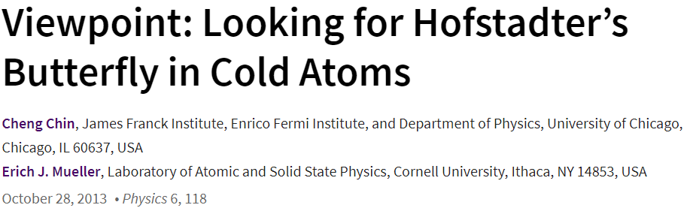
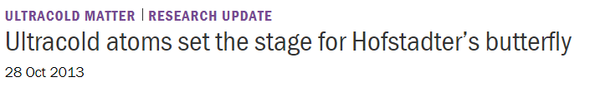

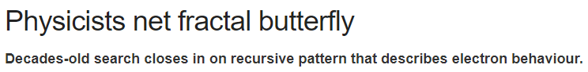
Artificial magnetic fields in an optical lattice

Slide 17
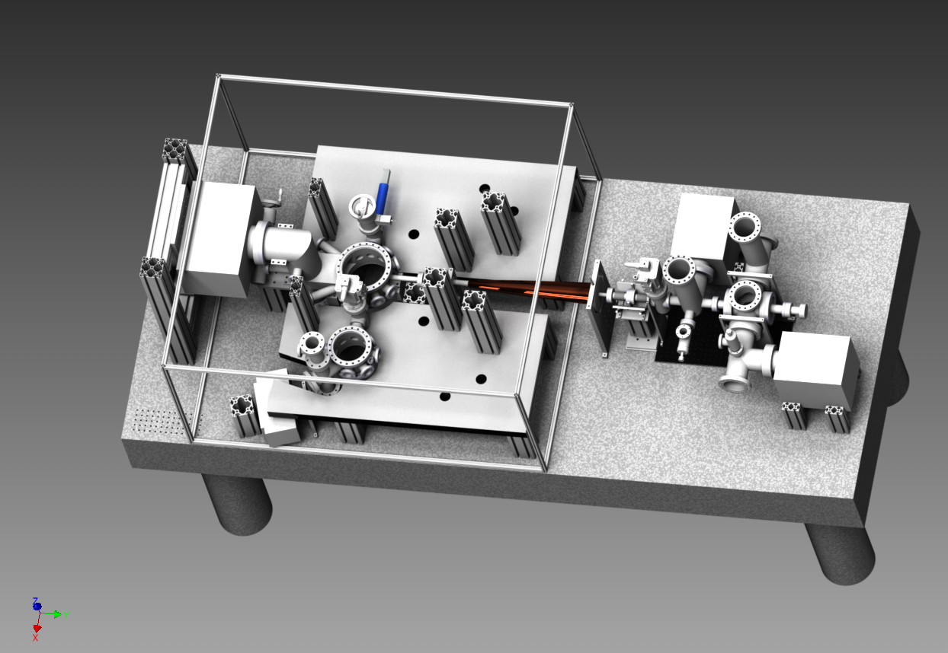


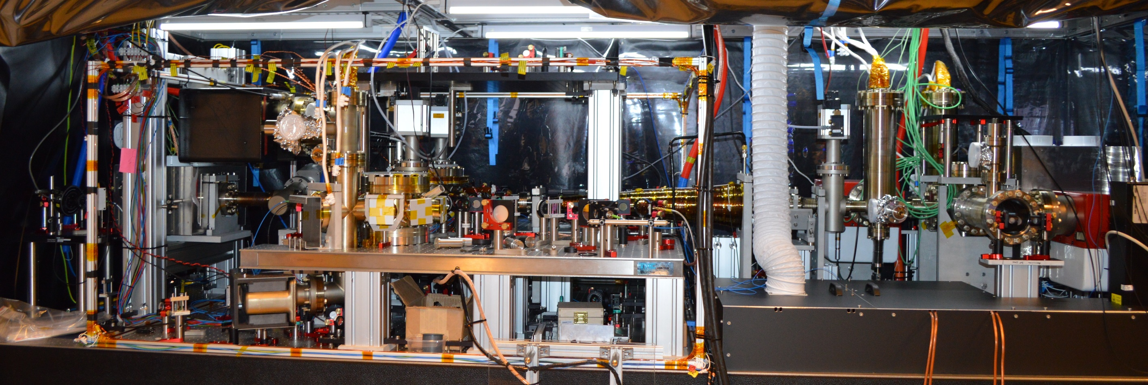
I designed and built a strontium quantum gas experiment

Slide 18
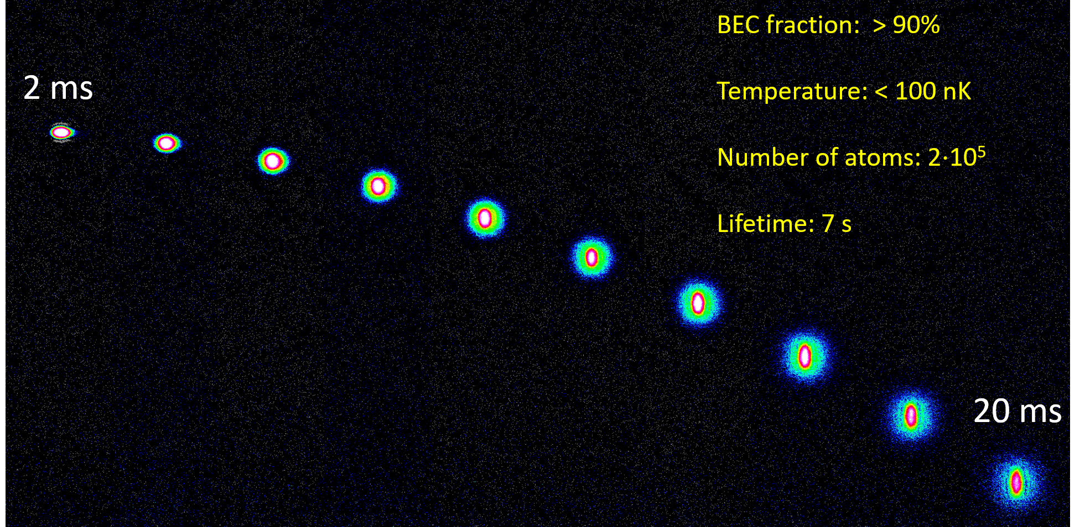
Free fall expansion of a ⁸⁴Sr BEC
We have created BEC and Fermi gases of strontium
(only few experiments in the world can do that)

Slide 19
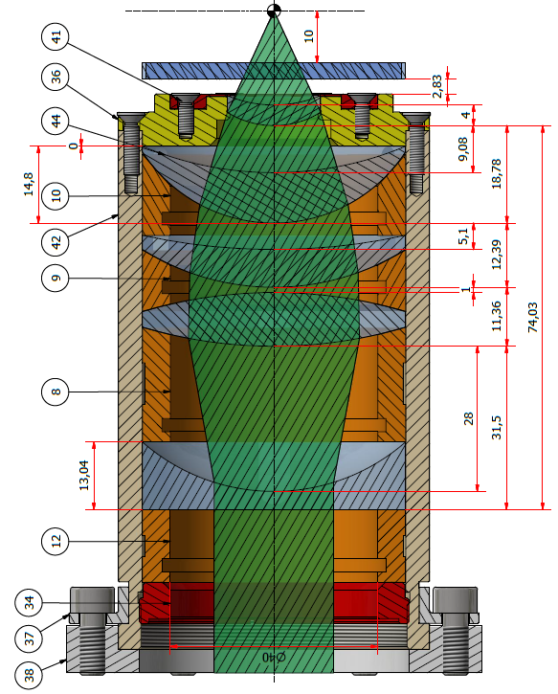
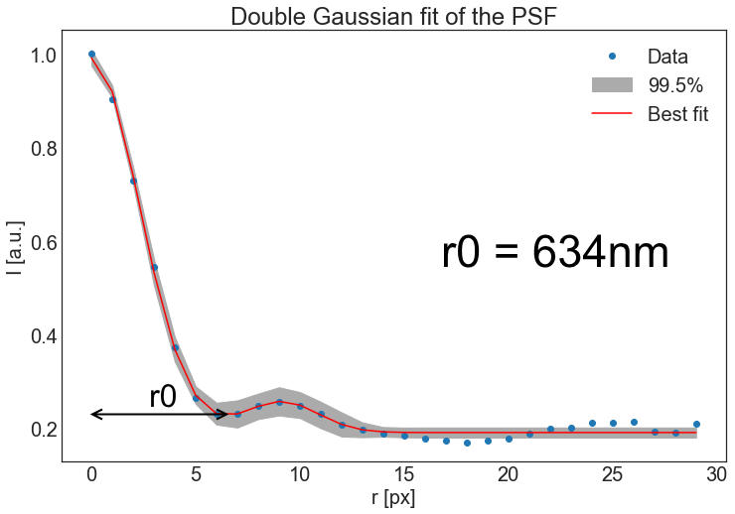
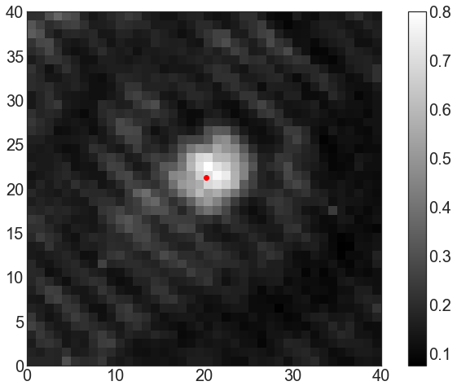
Microscope objective to resolve individual atoms in a lattice
I have designed a microscope capable of resolving individual lattice sites.
Notes:
6 randomly placed holes
2D Gaussian to find center
Double Gaussian fit
200nm holes

Slide 20
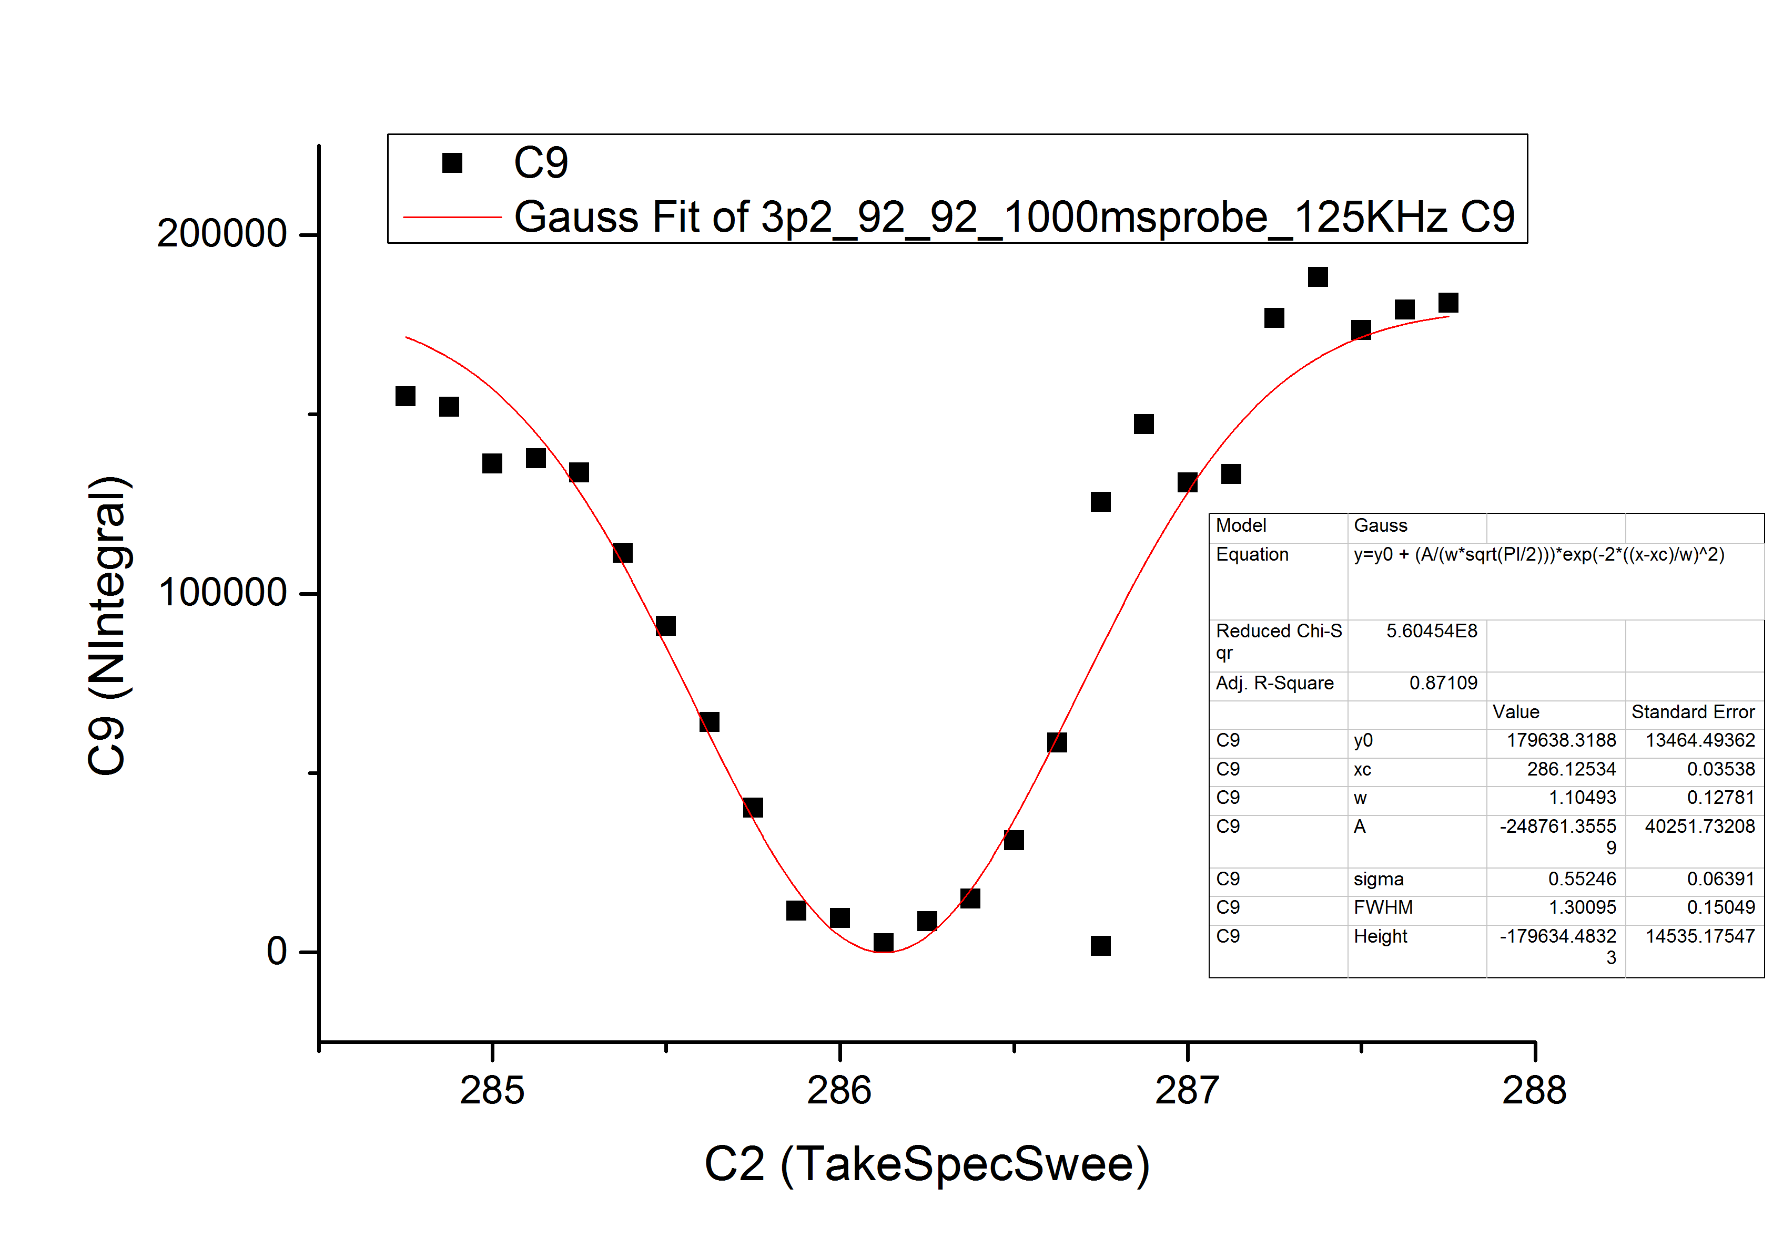
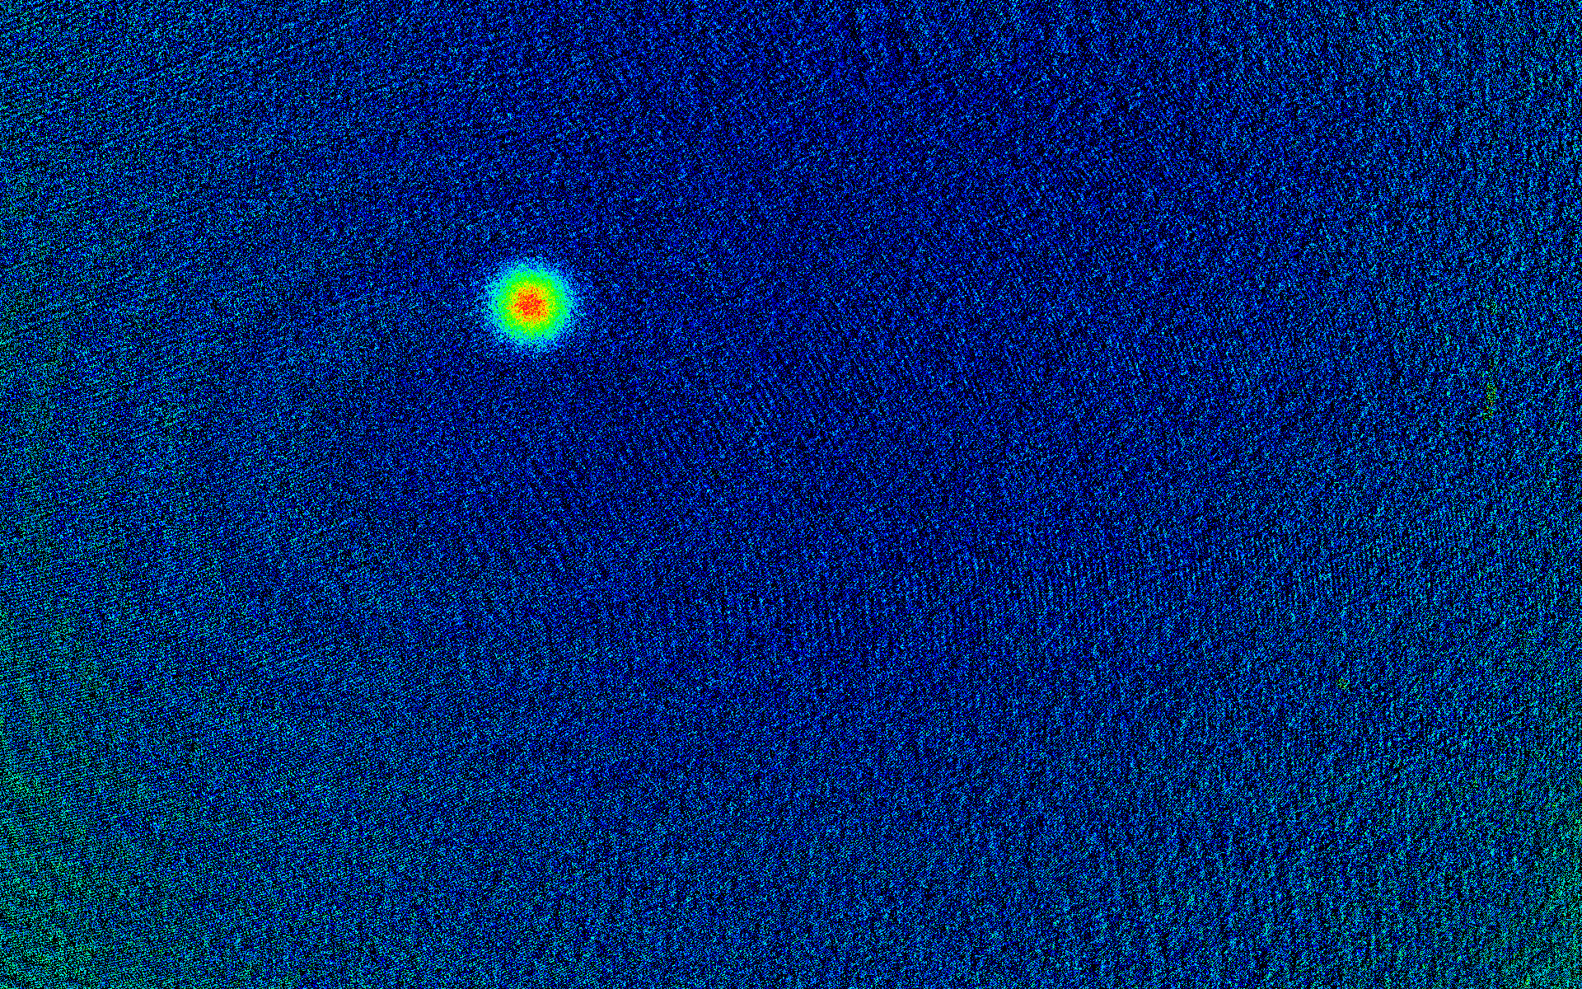
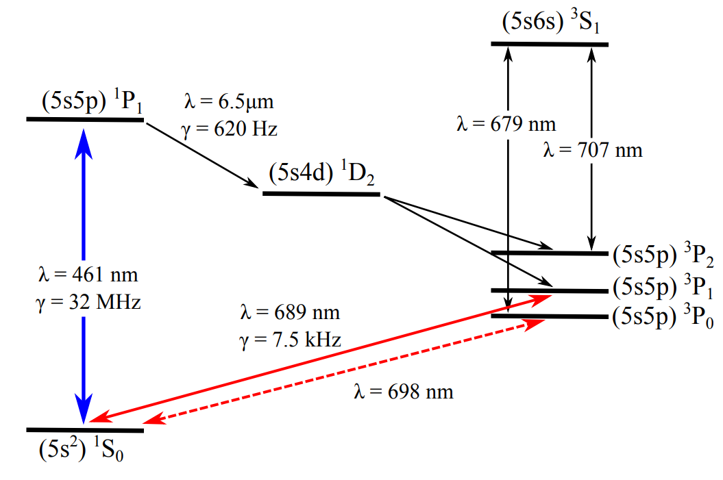
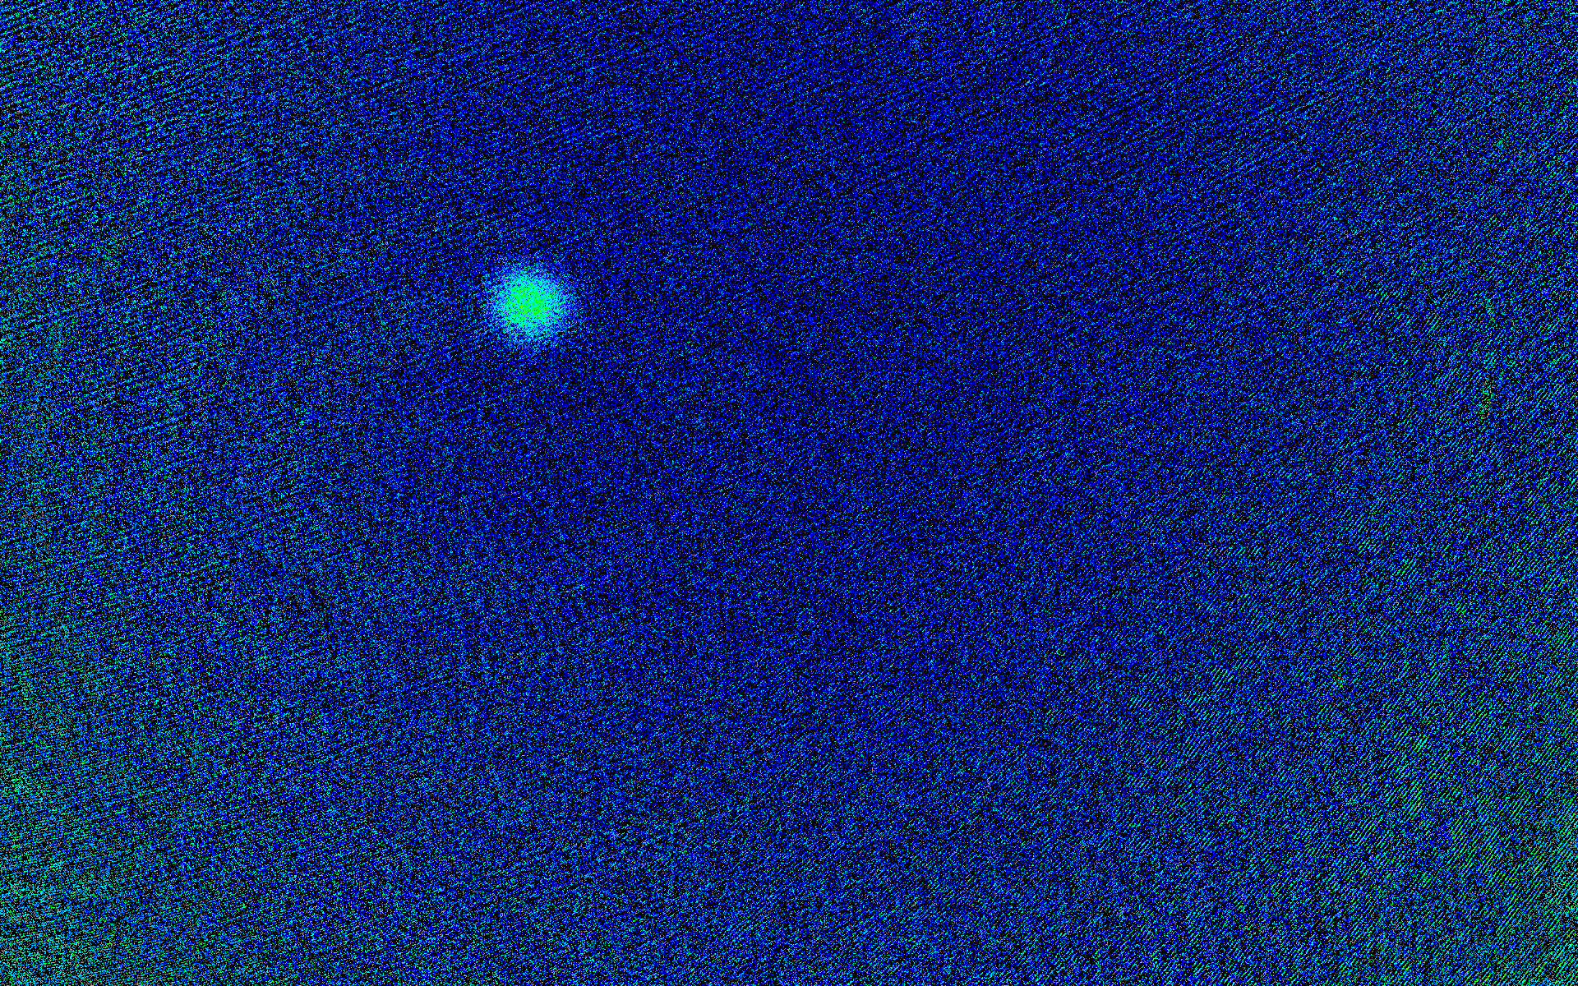
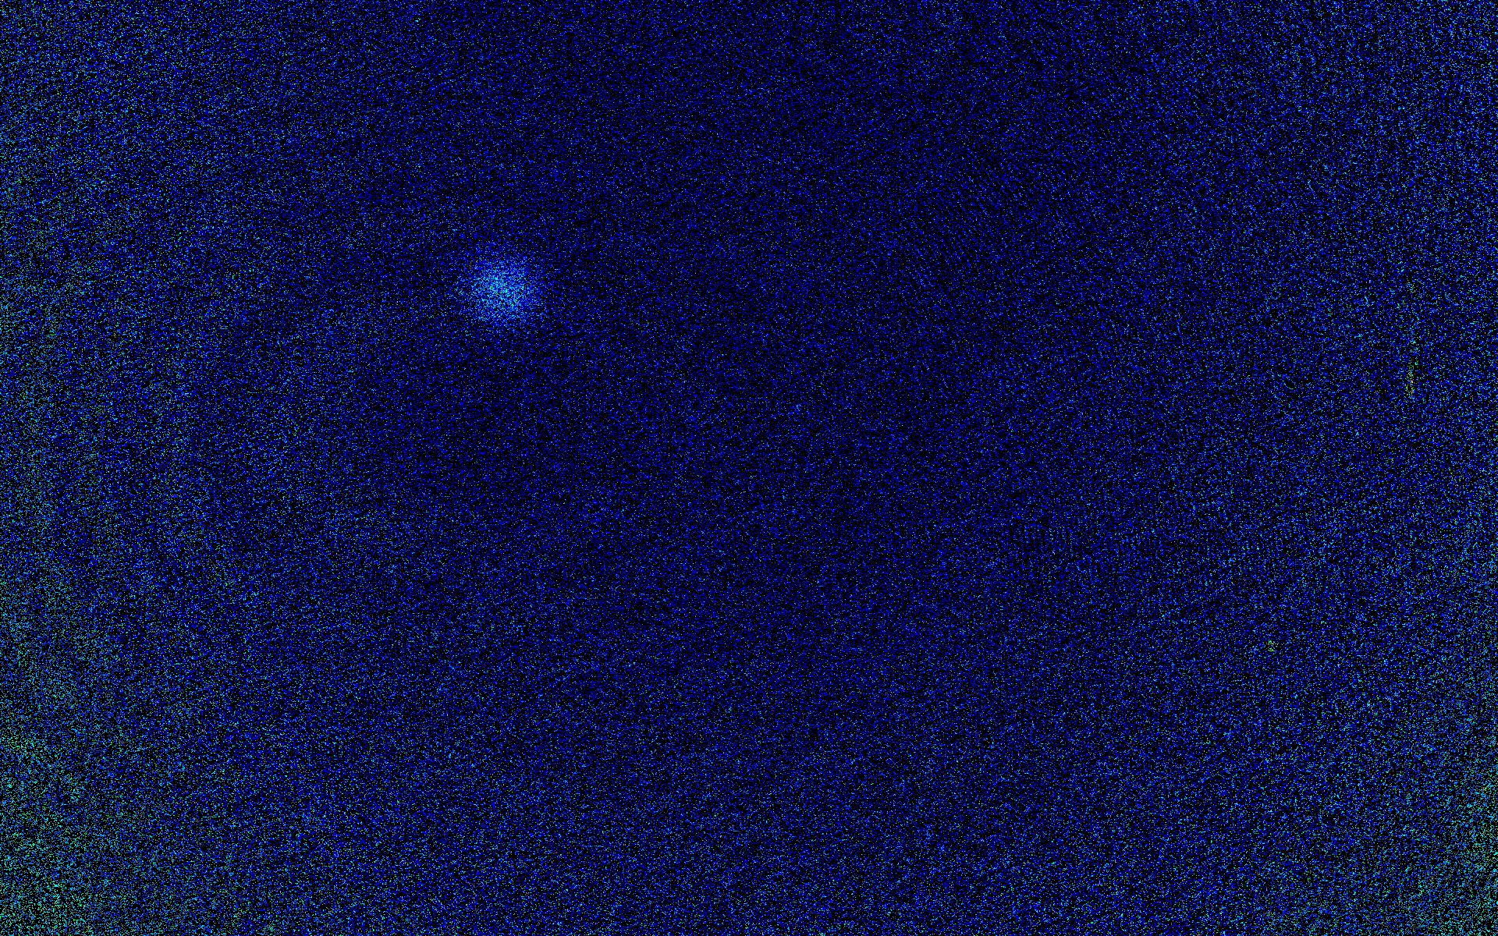
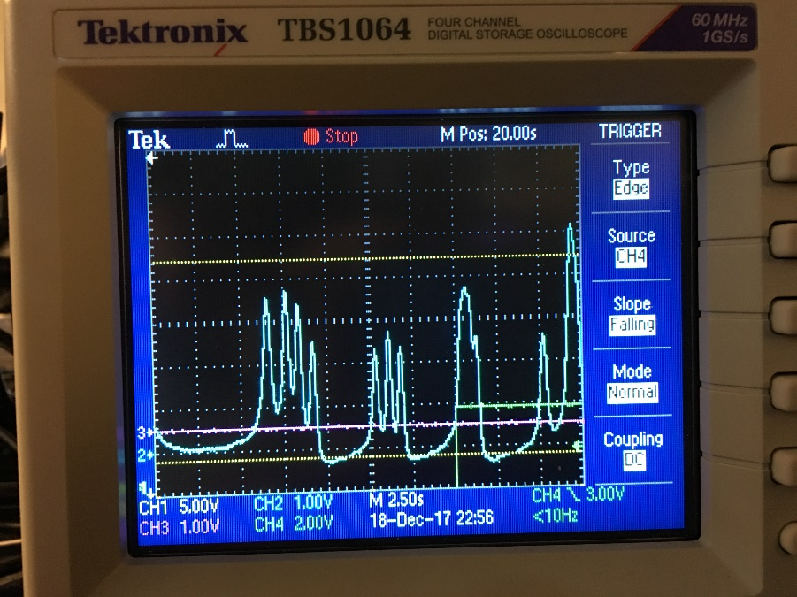
Spectroscopy for the ultranarrow transition ${{}_{ }^{1}S}_{0}{→{}_{ }^{3}{P_{2}}}_{ }$of ⁸⁷Sr
Number of atoms
AOM frequency (MHz)
?
First observation of the ultranarrow transition in fermionic Sr (<mHz)
Iodine spectroscopy
Observation of the ultranarrow doubly-forbidden transition in a Fermi gas of strontium (in preparation)
Notes:
6 randomly placed holes
2D Gaussian to find center
Double Gaussian fit
200nm holes

Slide 21
What I want to achieve next

Slide 22
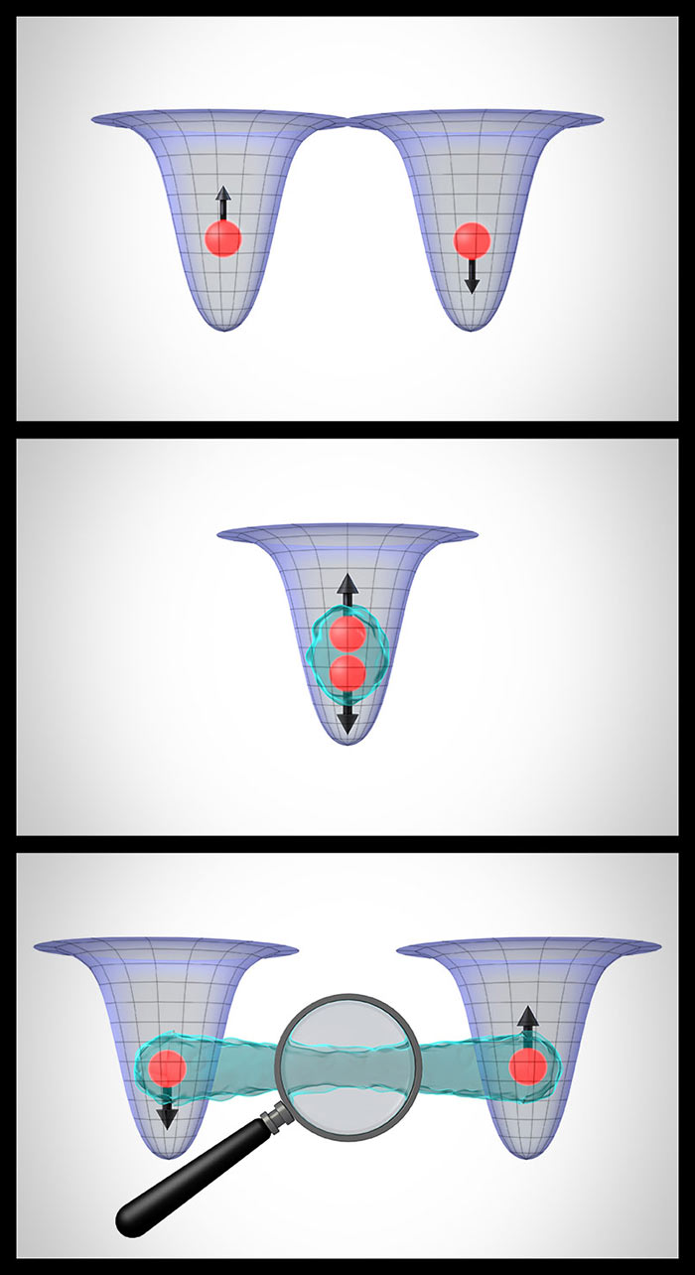
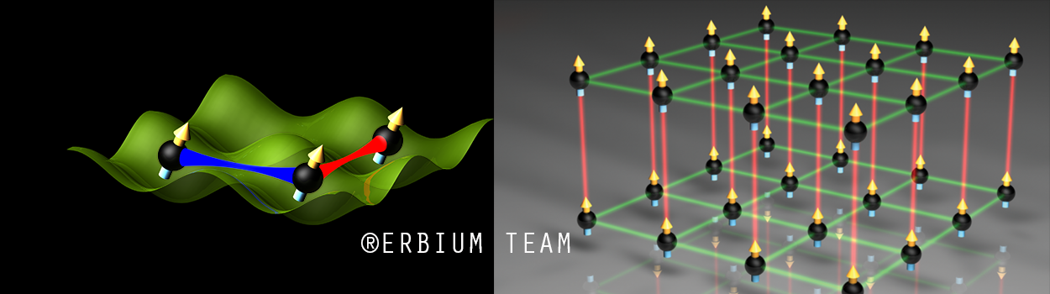
My plan for a quantum physics and quantum engineering lab
A few-atom quantum assembler
A quantum gas experiment
IQOQI
JILA

Slide 23
Why erbium?
IQOQI
Only 3 experiments in the world have BEC of erbium (Innsbruck, Bonn, Paris)
It has several stable fermionic and bosonic isotopes with high abundancy (>25%)
It is highly magnetic μ = 7μ_{Β} and thus strongly dipolar
A transition at 401 nm can lead to submicrometer resolution

Slide 24
How can I achieve that at Nankai University
Form a team with strong physics and engineering skills (4-5 team members)
Collaborate with the Nankai teams and former international colleagues
Standard optics lab space (100-200 m²)
Apply actively for (university, national, local) start-up funding (5-10 million RMB)

Slide 25
Thank you!

